Slide 1

'The Ascension Way' - Curriculum Intent – our vision
Vision: as an inclusive Christian School, we aim to create a loving, caring and respectful community, where individuals can flourish spiritually, socially and academically as children of God, in a rich learning environment. Our vision is to inspire lifelong learning whilst encouraging resilience, independence, aspiration and appreciation of God’s wonderful world.

Slide 2
Curriculum – that which is to be learned

Slide 3
Curriculum drivers -
principles that guide the development and delivery of that which is to be learned by the children.

Slide 4
Church of the Ascension Primary School Curriculum Drivers
Aspiration | Resilience
Grounded in research, subject leaders have designed our curriculum to ensure that children know more and remember more. Effective use of assessment for learning means that our curriculum is appropriately pitched, providing challenge and opportunities for deep thinking. We aim to develop children's natural curiosity and encourage them to drive their own learning forward. | A variety of teaching and learning strategies are used to inspire deep, meaningful connections within and across subject areas. Children are taught to build on what they already know: reviewing, revisiting and retaining prior knowledge over time. Through our behaviour curriculum, children are taught what to do if they are stuck. We encourage children to be resourceful and to solve problems. Children across school are given responsibilities and opportunities to be creative and use their own initiatives.

Slide 5
Church of the Ascension Primary School Curriculum Drivers
Appreciation | Independence
Our curriculum is designed to ensure that children feel valued as individuals as well as understanding their personal chronology and their place in our local, national and global context. Curriculum design ensures that pupils are supported to flourish spiritually, socially and academically. Children are inspired by the curriculum. Each subject being taught discretely so that children can flourish and see individual subjects as a valid potential career pathways. Children learn through our curriculum and Christian values, to have interest in and respect for others and their cultures and beliefs. | Our curriculum is enquiry based. Key questions provoke interest and enquiry. A progressive and sequential curriculum means that children can retrieve prior knowledge and recognise what they can already do, with increasing independence, as they move through school. Our curriculum encourages children to think deeply and communicate their ideas thoughtfully, respectfully and courageously. Our curriculum teaches pupils to keep safe and help make positive contributions to the school and local and global communities.

Slide 6
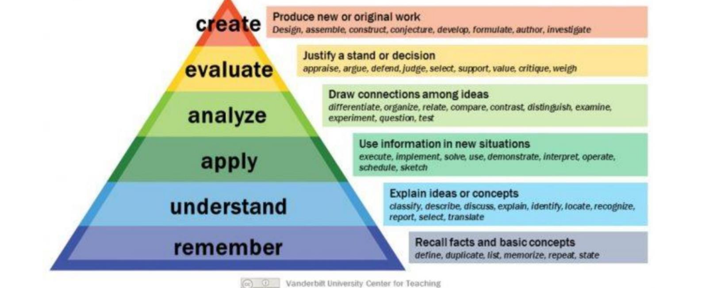
Church of the Ascension Primary School Curriculum Drivers
Rich learning environment
Our school site, local area, visits and visitors are used to enhance the learning experience of all pupils.
Consistent use of learning walls, in classrooms, ensure that children have access to the vocabulary and scaffolding that will support their success.
Achievements are celebrated and displayed, in school.
Strategies to ensure that all children are appropriately challenged, based on Bloom’s Taxonomy

Slide 7
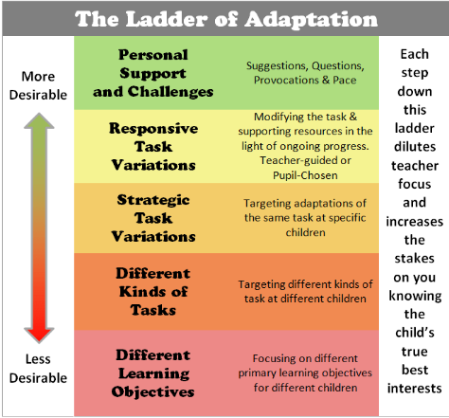
Inclusive
We aim to ensure that all children feel valued, supported and empowered to reach their full, God given, potential.
We are dedicated to providing a curriculum that supports all learning styles, needs and abilities.
We ensure that our curriculum is accessible for all pupils with SEND (special educational needs and disabilities).
Our curriculum is rooted in our Christian Vision and promotes equality through our Core Christian Values of thankfulness, generosity, respect, forgiveness, honesty and perseverance.
Close working partnerships with families, outside agencies, the Parish and wider community, enhance our curriculum and support our children’s flourishing.
Strategies used to ensure inclusivity in our curriculum are:
*Adaptive Teaching – great teaching, using a variety of both planned and micro-adaptations, ensure that all pupils are supported to achieve well, in lessons.
*Flexibility in teaching methods – these can include visual aids, practical experiences, think-pair-share and mixed ability group work, help to engage all learners.
*Individual support as outlined in Individual Education Plans.
*Effective use of Live Marking Policy to identify and address any errors and misconceptions.
*Assessment for learning informs next steps.

Slide 8

'The Ascension Way' - Curriculum Intent – Curriculum Drivers subject specific - please see our subject policies.
Notes:
Check – add to and amend for your subject area.

